Slide 1

Linear Regression

Slide 2
Linear Regression
Linear regression: Linear regression involves using data to calculate a line that best fits that data, and then using that line to predict scores on one variable from another. Prediction is simply the process of estimating scores of the outcome (or dependent) variable based on the scores of the predictor (or independent) variable. To generate the regression line, we look for a line of best fit. A line which can explain the relationship between independent and dependent variable(s), better is said to be best fit line. The difference between the observed value and actual value gives the error.
Linear Regression gives an equation of the following form:
Y = m0 + m1x1 + m2x2 + m3x3 +…….mnxn
where Y is the dependent variable and X’s are the independent variables.
The right-hand side of this equation is also known as Hypothesis Function - H(x)

Slide 3
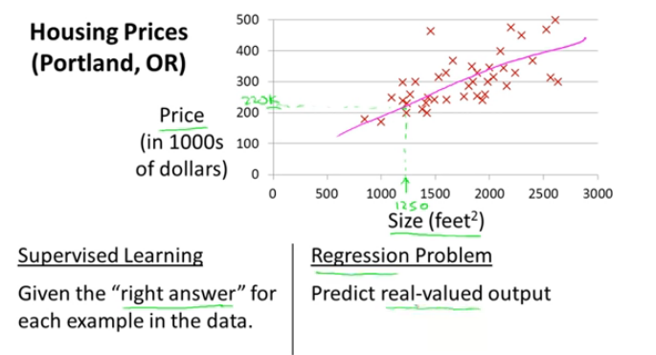
Linear Regression

Slide 4
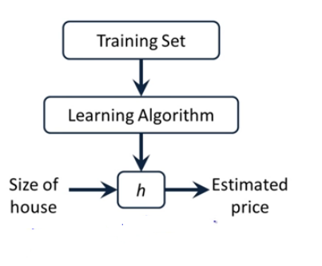
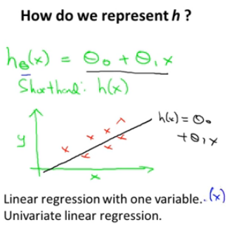
Linear Regression

Slide 5


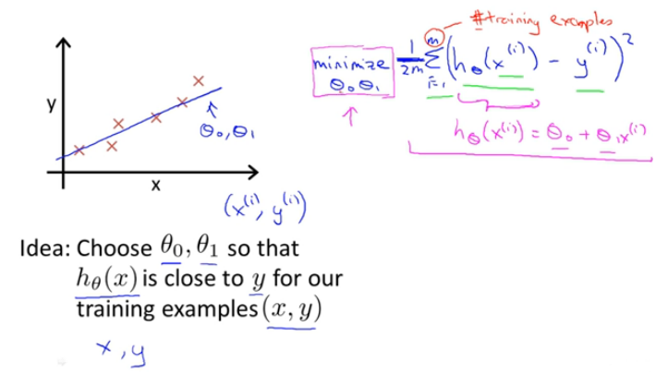
Linear Regression

Slide 6
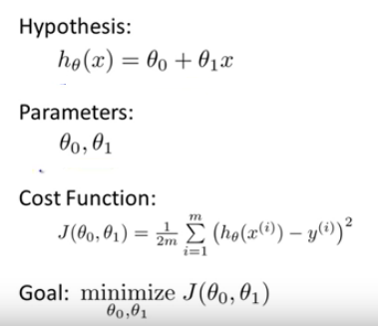
Linear Regression

Slide 7
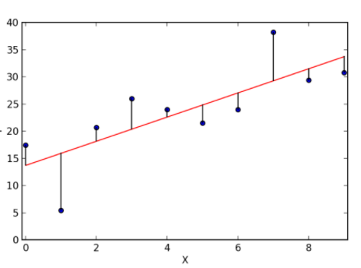
Line of Best Fit
The purpose of line of best fit is that the predicted values should be as close as possible to the actual or observed values. This means the main objective in determining the line of best fit is to “minimize” the difference predicted values and observed values. These differences are called “errors” or “residuals”.
3 ways to calculate the “error”
Sum of all errors: (∑(Y – h(X))) (This may result in the cancellation of positive and negative errors. This will not be a correct metric to use)
Sum of absolute value of all errors: (∑|Y-h(X)|)
Sum of square of all errors ( ∑ (Y-h(X))²)
The line of best fit for 1 feature can be represented as :
Y= bx +c Where Y is the score or outcome
variable we are trying to predict
B = regression coefficient or slope
C = Y intercept or the regression constant
This is Linear regression with 1 variable.

Slide 8
Sum of Squared Errors
Squaring the difference between actual value and predicted value “penalizes” more for each error. Hence minimizing the sum of squared errors improves the quality of regression line.
This method of fitting the data line so that there is minimal difference between the observations and the line is called the method of least squares.
Baseline model refers to the line which predicts each value as the average of the data points.
SSE or Sum of Squared Errors is the total of all squares of the errors. It is a measure of the quality of regression line. SSE is sensitive to the number of input data points.

Slide 9

Regression Metrics
Mean Absolute Error : One way to measure error is by using absolute error to find the predicted distance from the true value. The mean absolute error takes the total absolute error of each example and averages the error based on the number of data points. By adding up all the absolute values of errors of a model we can avoid canceling out errors from being too high or below the true values and get an overall error metric to evaluate the model on.
Mean Squared Error : Mean squared is the most common metric to measure model performance. In contrast with absolute error, the residual error (the difference between predicted and the true value) is squared.
Some benefits of squaring the residual error is that error terms are positive, it emphasizes larger errors over smaller errors, and is differentiable. Being differentiable allows us to use calculus to find minimum or maximum values, often resulting in being more computationally efficient.
R-Squared: Its called coefficient of determination. The values for R² range from 0 to 1, and it determines how much of the total variation in Y is explained by the variation in X. A model with an R² of 0 is no better than a model that always predicts the mean of the target variable, whereas a model with an R² of 1 perfectly predicts the target variable. Any value between 0 and 1 indicates what percentage of the target variable, using this model, can be explained by the features. A model can be given a negative R² as well, which indicates that the model is arbitrarily worse than one that always predicts the mean of the target variable.

Slide 10

Cost Function
The error of regression model is expressed as a cost function :
Its is similar to sum of squared errors. 1/m is means, we are calculating the average. The factor ½ is used to simplify mathematics. This function is minimized to reduce errors in prediction.
Minimizing this function, means we get the values of θ₀ and θ₁ which find on average the minimal deviation of x from y when we use those parameters in our hypothesis function.

Slide 11
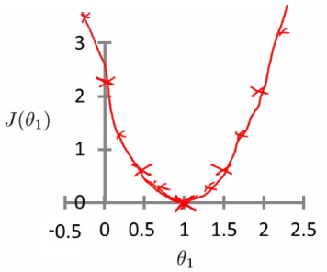
Inside Cost Function
Cost function :
Lets assume, θ₀ is 0. (Our hypothesis passes through origin)
So, now we need that value of θ₁ for which Cost function is minimum. To find that out, plot J(θ₁) vs θ₁

Slide 12
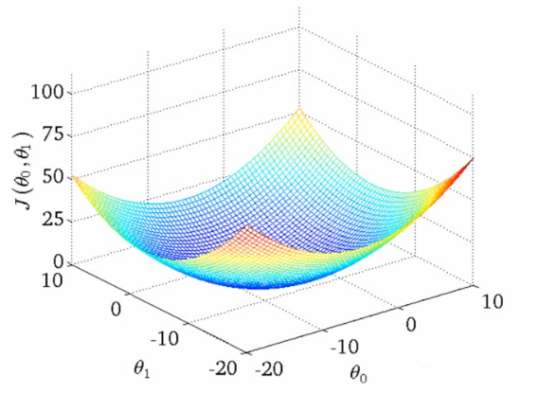
Inside Cost Function
Cost function :
With both θ₀ and θ_{1,} The plot becomes more complex
So, now we need that value of θ₁ for which Cost function is minimum. To find that out, plot J(θ_{1,} θ₀ ) vs θ₁ and θ₀

Slide 13
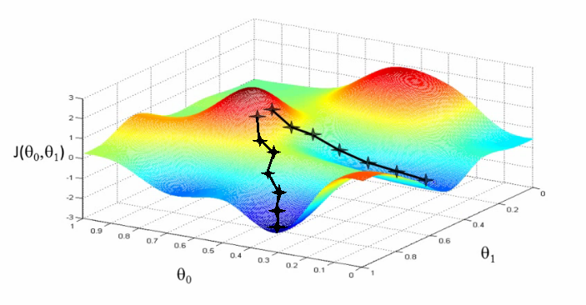
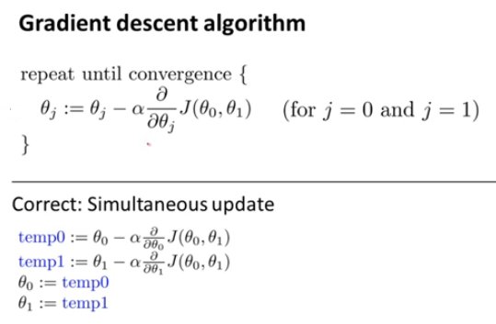
Gradient Descent
The process of minimizing the cost function can be achieved by Gradient Descent algorithm:
The steps are:
Start with initial guess of coefficients
Keep changing the coefficients a little bit to try and reduce Cost Function J(θ₀,θ₁)
Each time, the parameters are changed, the gradient is chosen which reduces J(θ₀,θ₁) the most.
Repeat
Keep doing till no improvement is made.

Slide 14
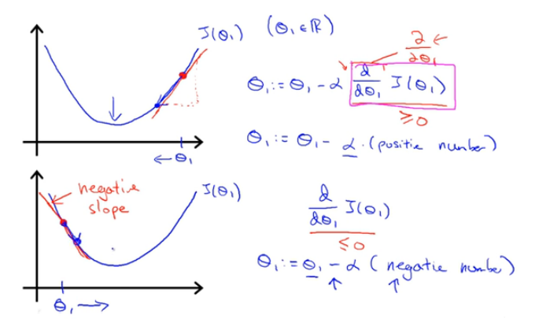
Gradient Descent

Slide 15
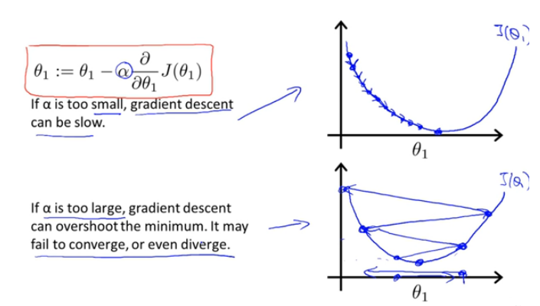
Gradient Descent

Slide 16
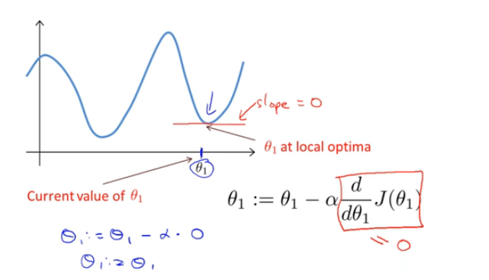
Gradient Descent

Slide 17
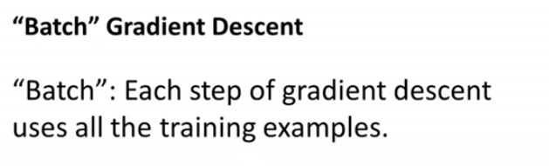
Gradient Descent

Slide 18
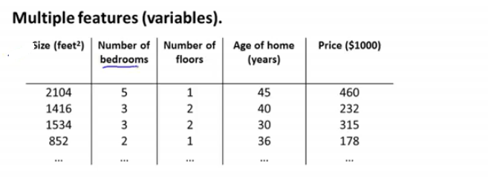
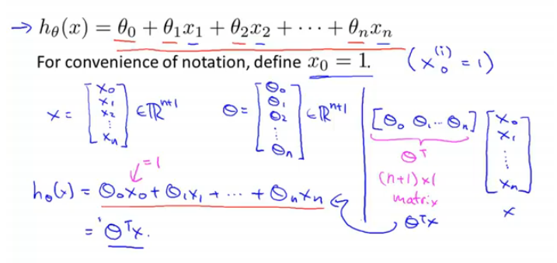
Linear Regression with multi variables

Slide 19
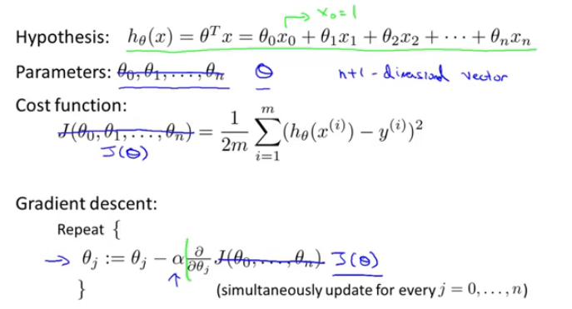
Cost function for multi variables

Slide 20
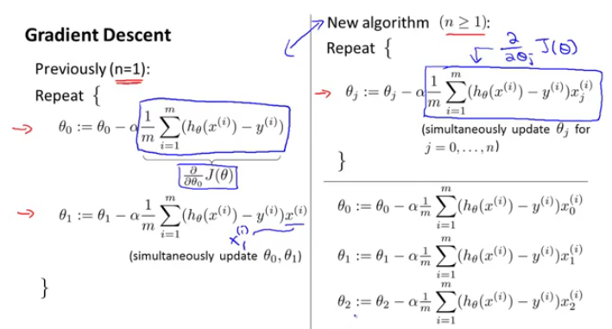
Cost function for multi variables

Slide 21
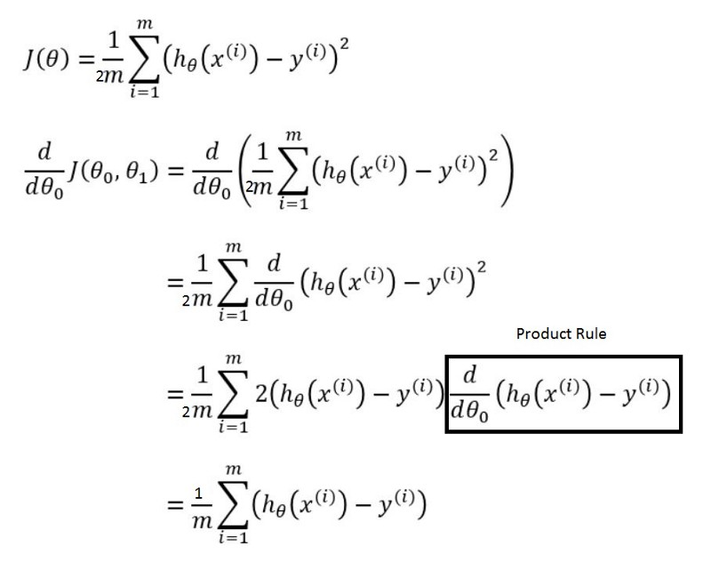
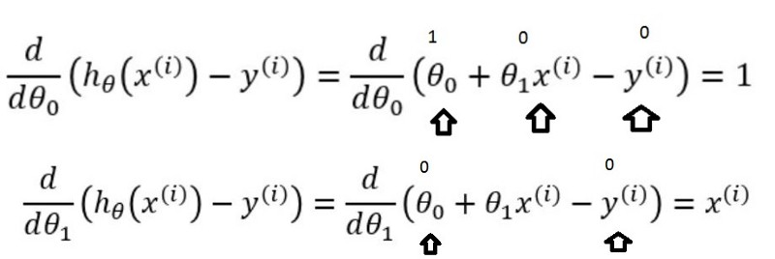
Cost function for multi variables

Slide 22
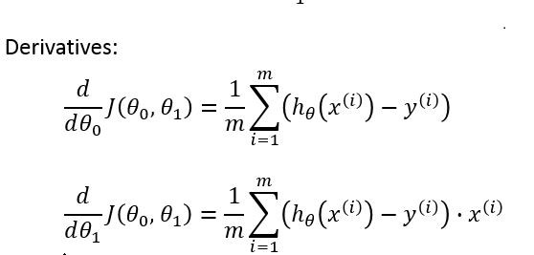
Cost function for multi variables

Slide 23
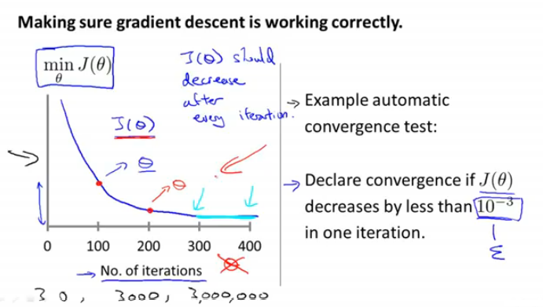
How gradient descent is working?

Slide 24
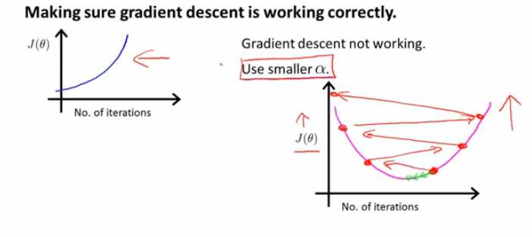
How gradient descent is working?

Slide 25
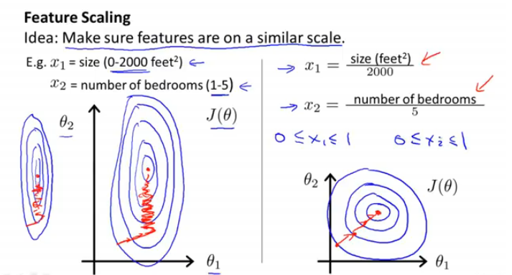
Feature Scaling

Slide 26
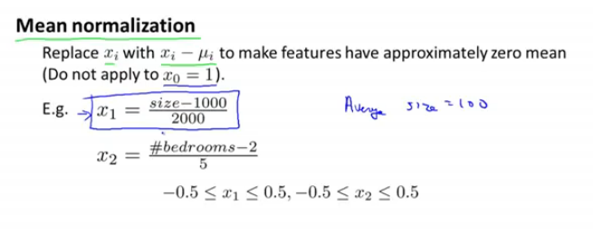
Feature Scaling

Slide 27
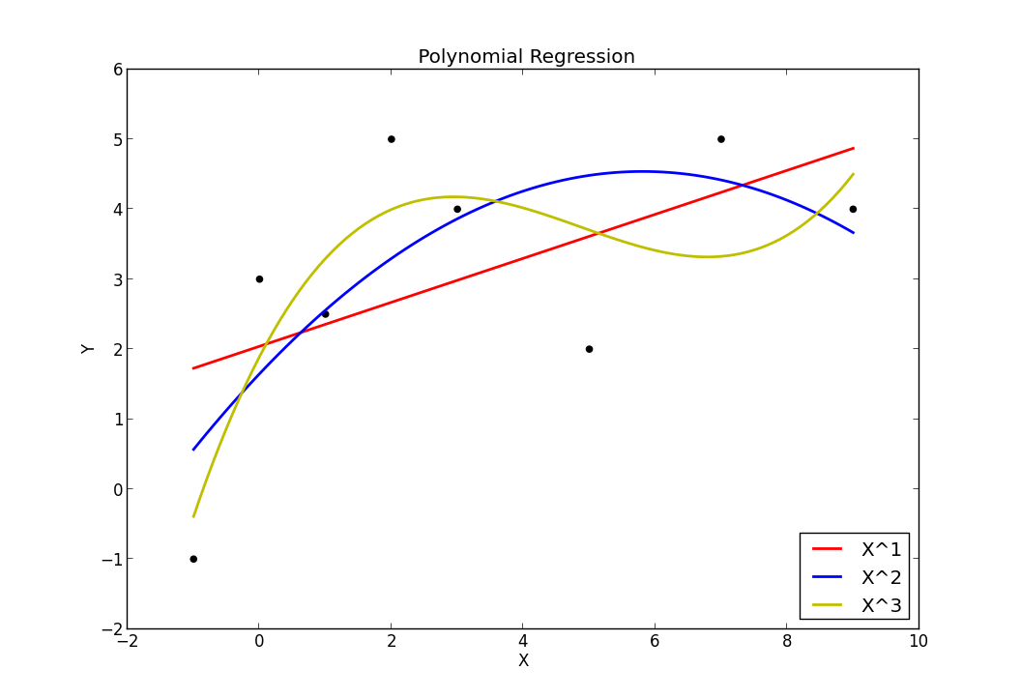
Polynomial Regression
Instead of finding a best fit “line” on the given data points, we can also try to find the best fit “curve”.
This is the form of Polynomial regression. The equation, in case of second-order polynomial will be:
Y = θ₀+ θ₁x+ θ₂x² (Quadratic Regression)
Third-order polynomial will be:
Y = θ₀+ θ₁x+ θ₂x² + θ₃x³ (Cubic Regression)
When we use higher order powers in our regression model, we say that we are increasing the “complexity” of the model. The more the complexity of the model, the better it will “fit” on the given data.

Slide 28
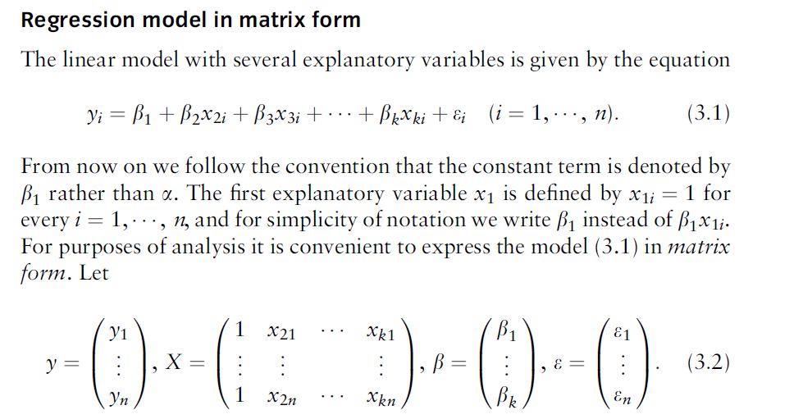
Normal Equation for finding coefficients

Slide 29
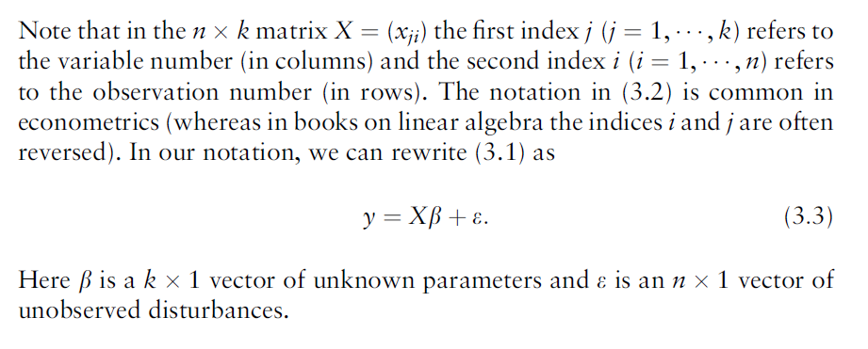
Normal Equation for finding coefficients

Slide 30
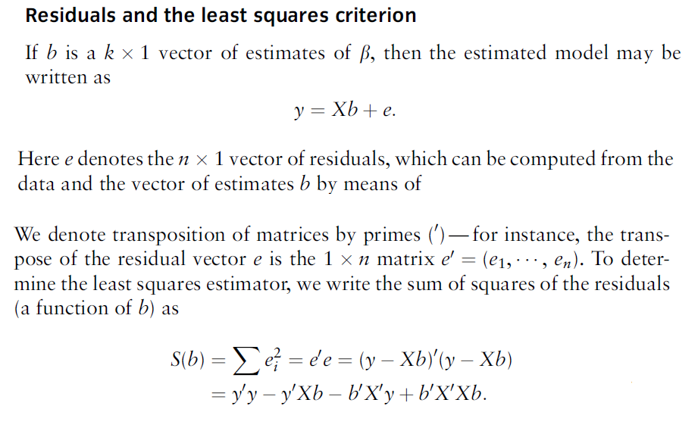
Normal Equation for finding coefficients

Slide 31
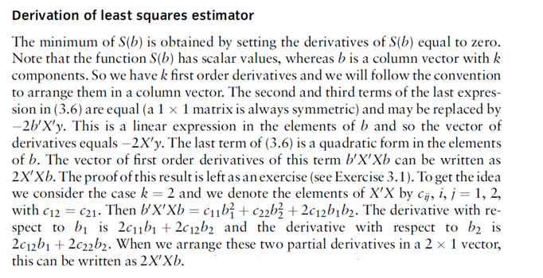
Normal Equation for finding coefficients

Slide 32
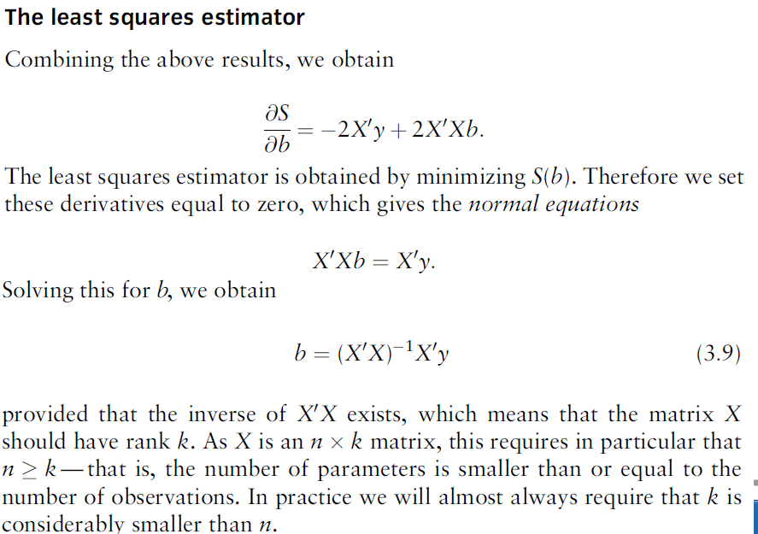
Normal Equation for finding coefficients

Slide 33
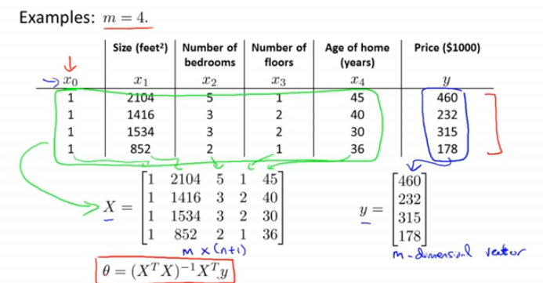
Normal Equation for finding coefficients

Slide 34
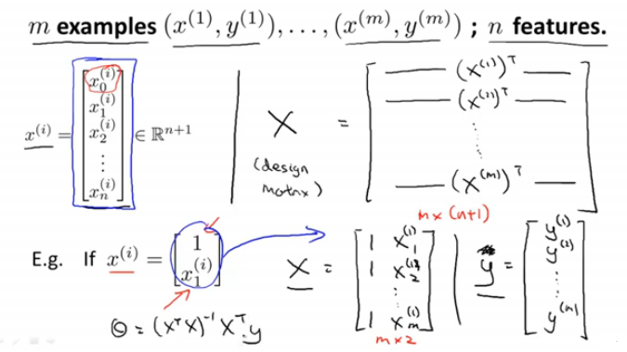
Normal Equation for finding coefficients

Slide 35
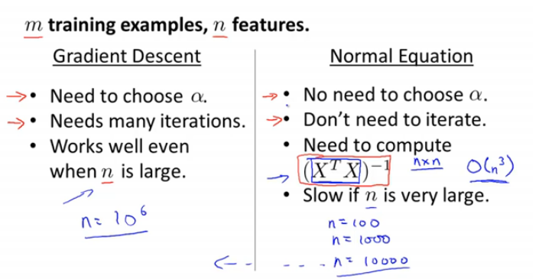
Normal Equation for finding coefficients

Slide 36
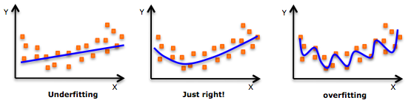
Overfitting and Underfitting
So, should we always choose a “complex” model with higher order polynomials to fit the data set?
NO, it may be possible that such a model gives very wrong predictions on Test data. Though it fits well on training data but fails to estimate the real relationship among variables beyond the training set. This is known as “Over-fitting”
Similarly, we can have underfitting, it occurs when our model neither fits the training data nor generalizes on the new data.

Slide 37
Bias and Variance
Bias: Bias occurs when a model has enough data but is not complex enough to capture the underlying relationships(or patterns). As a result, the model consistently and systematically misrepresents the data, leading to low accuracy in prediction. This is known as underfitting. Simply put, bias occurs when we have an inadequate model. (Pays too little attention to data; does the same thing over and over again; high error on training set)
Variance: When training a model, we typically use a limited number of samples from a larger population. If we repeatedly train a model with randomly selected subsets of data, we would expect its predictions to be different based on the specific examples given to it. Here variance is a measure of how much the predictions vary for any given test sample. (Pays too much attention to data; high error on test set)
Some variance is normal, but too much variance indicates that the model is unable to generalize its predictions to the larger population. High sensitivity to the training set is also known as overfitting, and generally occurs when either the model is too complex or when we do not have enough data to support it.
We can typically reduce the variability of a model's predictions and increase precision by training on more data. If more data is unavailable, we can also control variance by limiting our model's complexity.

Slide 38

Adjusted R-Squared
R-square will increase or remain constant, if we add new predictors to our model. So there is no way to judge that by increasing complexity of the model, are we making it more accurate?
We “adjust” R-Square formula to include no of predictors in the model. The adjusted R-Square only increases if the new term improves the model accuracy.
R² = Sample R square
p = Number of predictors
N = total sample size

Slide 39
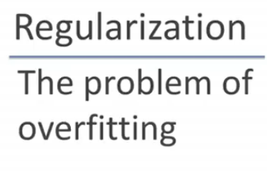
Ways to Address Overfitting

Slide 40
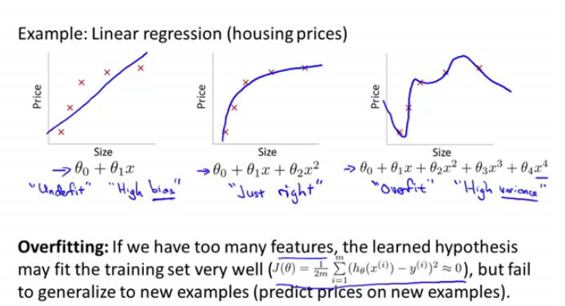

Slide 41
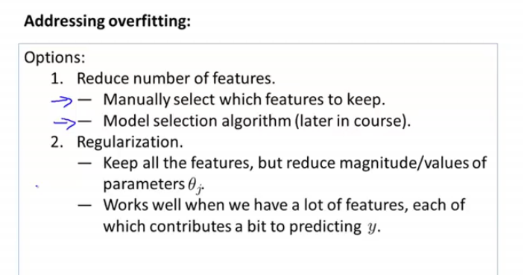

Slide 42
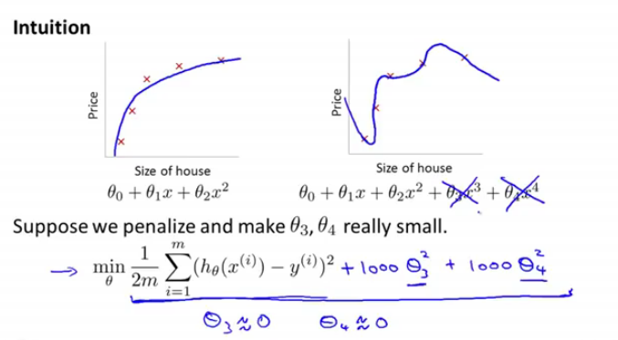

Slide 43
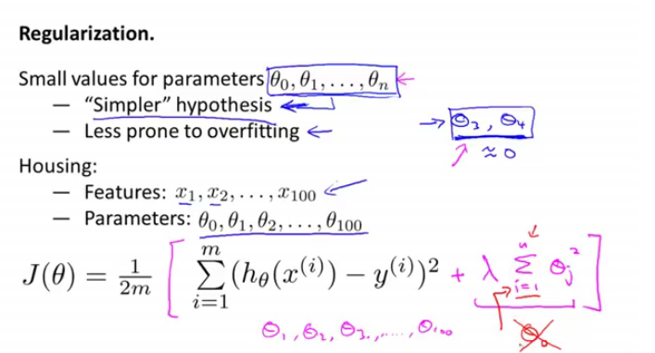

Slide 44
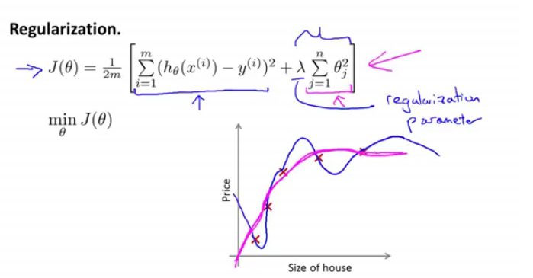

Slide 45
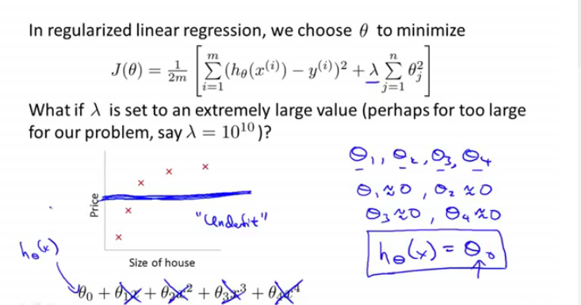

Slide 46
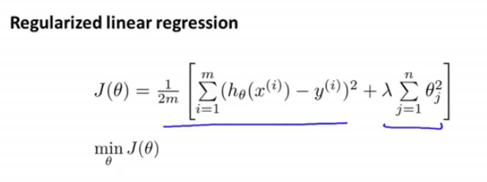

Slide 47
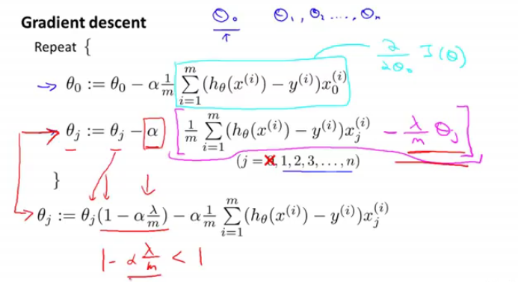

Slide 48
Assumption of Linear Regression about data
Linearity
Multivariate Normal
No or Little Multicollinearity
No Auto-correlation
Homoscedasticity or Equal Variance
Outliers

